Slide 1
Solution to
Algebraic &Transcendental Equations
A

Slide 2
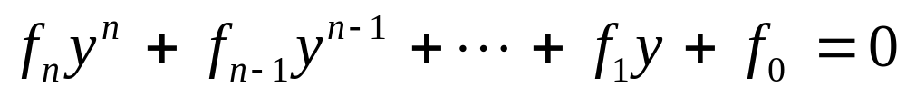
Algebraic functions
The general form of an Algebraic function:
f_{i} = an i-th order polynomial.
Example :
f₃
f₂
f₀
Polynomials are a simple class of algebraic function
a_{i}’s are constants.

Slide 3
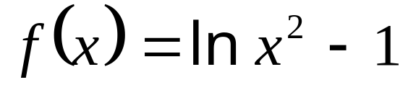
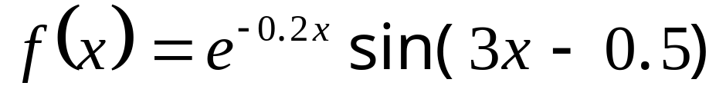
Transcendental functions
A transcendental function is non-algebraic.
May include trigonometric, exponential, logarithmic functions
Examples:

Slide 4




Equation Solving
Given an approximate location (initial value)
find a single real root
A
Root
Finding
non-linear
Single variable
Open
Methods
Brackting
Methods
Iterative
False-
position
Newton-
Rapson
Bisection
Secant

Slide 5
Iterative method
A.1

Slide 6
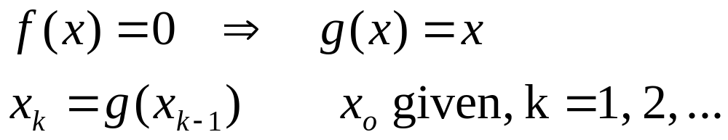
Simple Fixed-point Iteration
Rearrange the function so that x is on the left side of the equation:
Now progressively estimate the value of x.

Slide 7
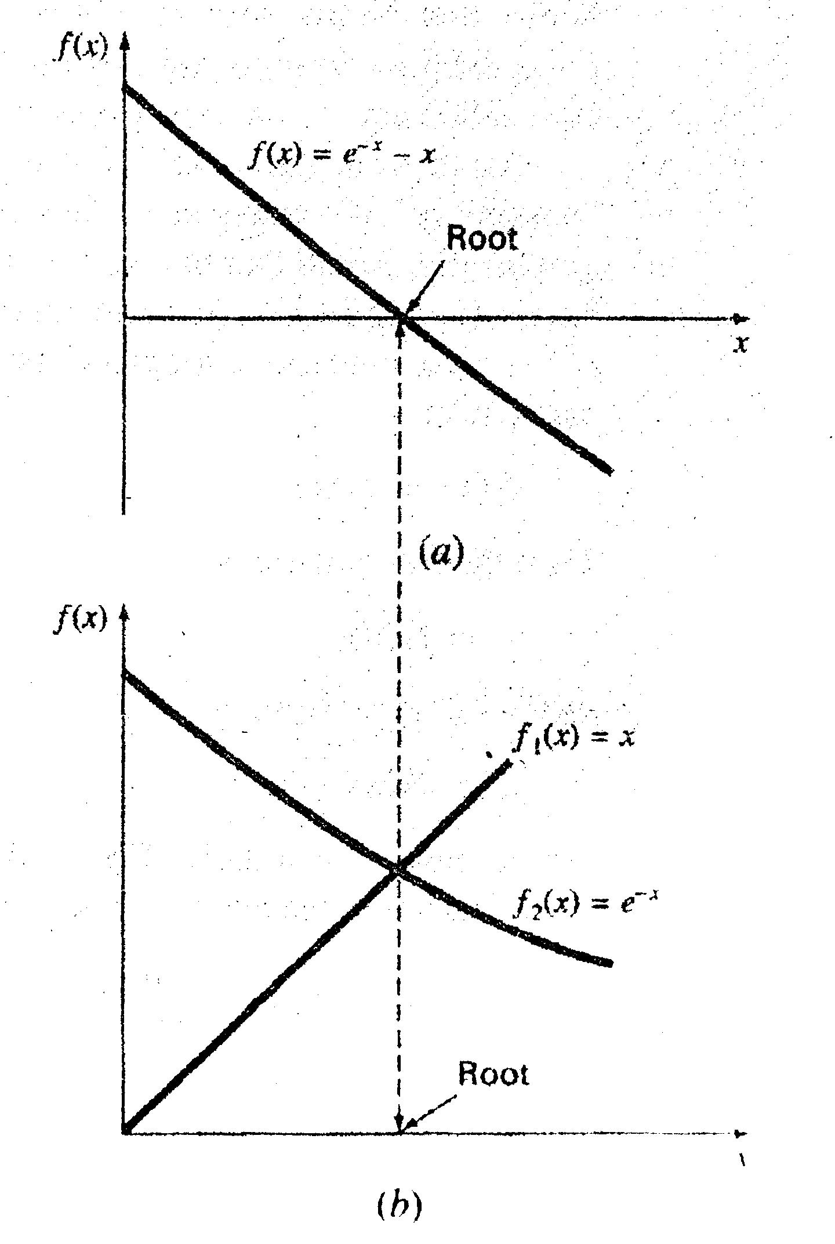
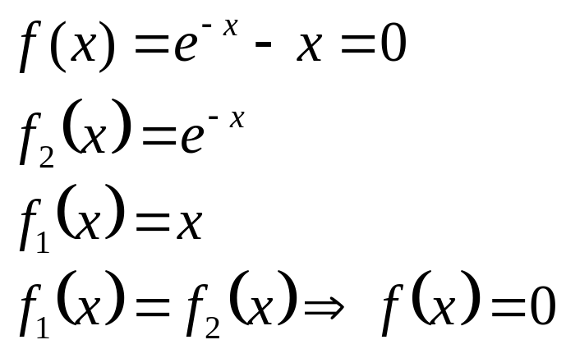
Problem
Find the root of
f(x) = e^{-x} – x
There is no exact or analytic solution
Numerical solution:

Slide 8
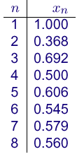
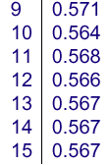
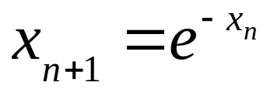

Iterative Solution
Start with a guess say x₁=1,
Generate
  x₂=e^{-x1} = e⁻¹= 0.368
  x₃=e^{-x2}= e^{-0.368} = 0.692
  x₄=e^{-x3}= e^{-0.692}=0.500
  In general:
  After a few more iteration we will get

Slide 9
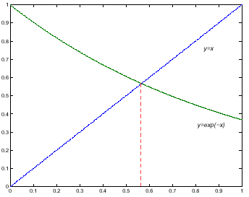
Iteration

Slide 10
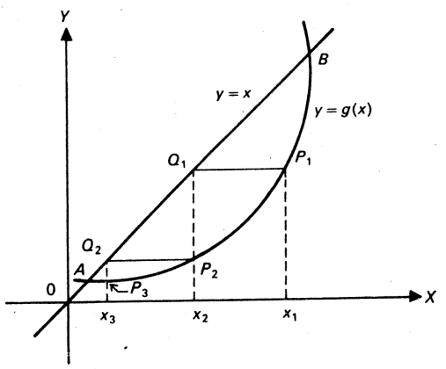
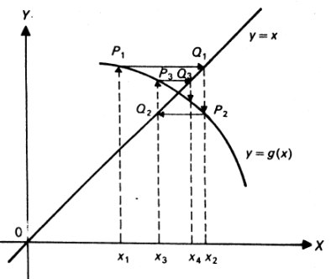
Convergence Examples
Convergent staircase pattern
Convergent spiral pattern

Slide 11
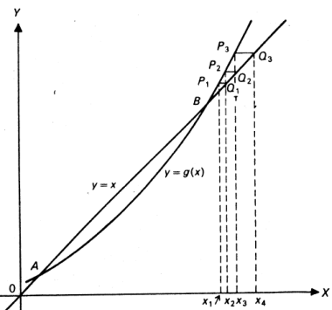
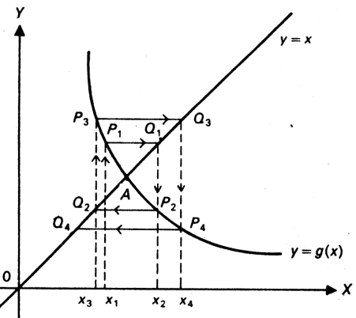
Divergence Example
Divergent staircase pattern
Divergent spiral pattern

Slide 12
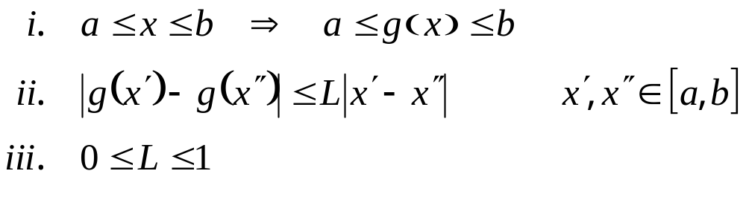
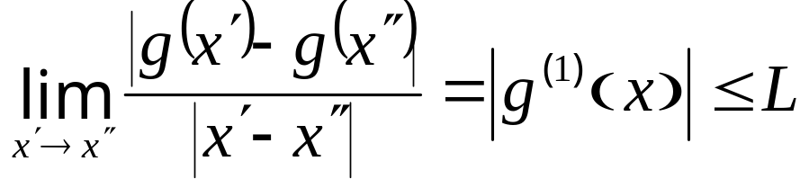
Existence of Root
There exists one and only one root if
  L is Lipschitz constant,

Slide 13
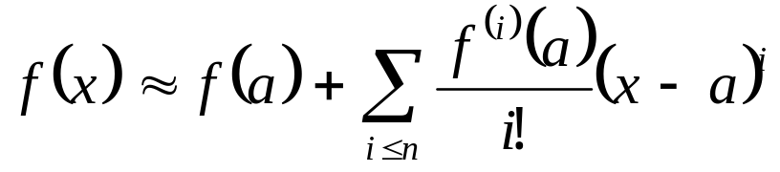
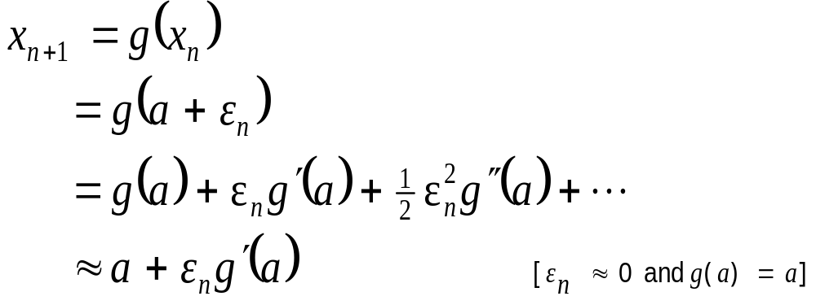
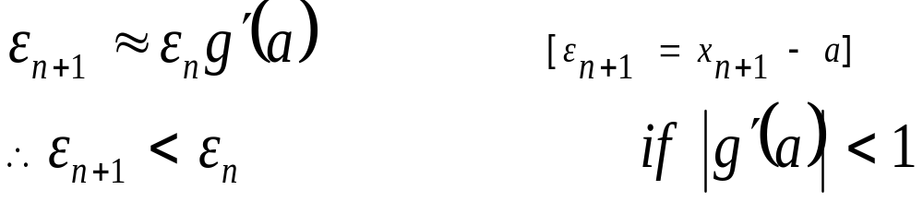
Convergence?
If x=a is a solution then,
error reduces at each step
i.e. iteration will converge
If magnitude of 1st derivative
at x=a is less than 1

Slide 14




Problem
Find a root near x=1.0 and x=2.0
Solution:
  Starting at x=1, x=0.292893 at 15th iteration
  Starting at x=2, it will not converge
  Why? Relate to g'(x)=x. for convergence g'(x) < 1
  Starting at x=1, x=1.707 at iteration 19
  Starting at x=2, x=1.707 at iteration 12
  Why? Relate to

Slide 15
Aitken’s Process
A.2

Slide 16
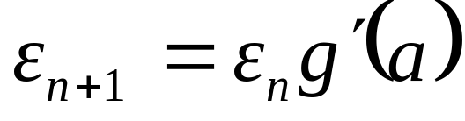
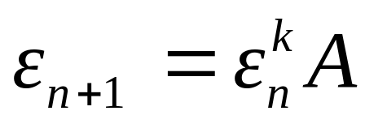
k^{th} Order Convergence
Pervious iterative method has linear (1st order) convergence, since:
For kth order convergence we have:
Now consider a 2nd order method.
Aitken’s Δ² process

Slide 17
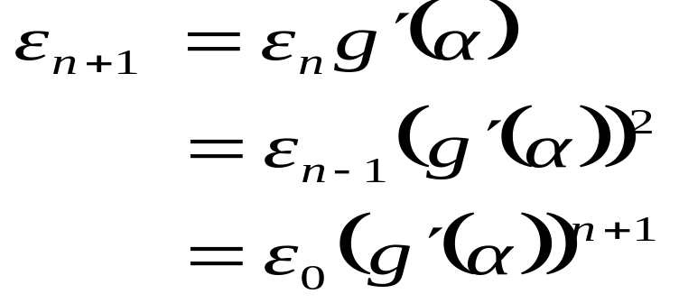
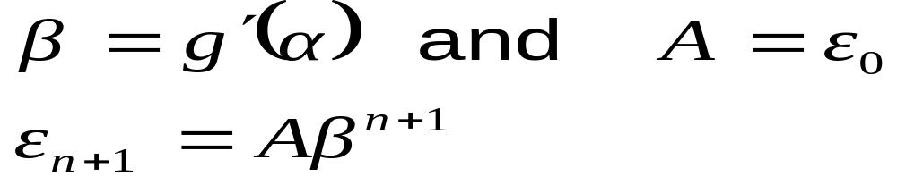
Aitken’s process
If α is a root of the equation i.e., α=g(α) then,
Now if we use

Slide 18
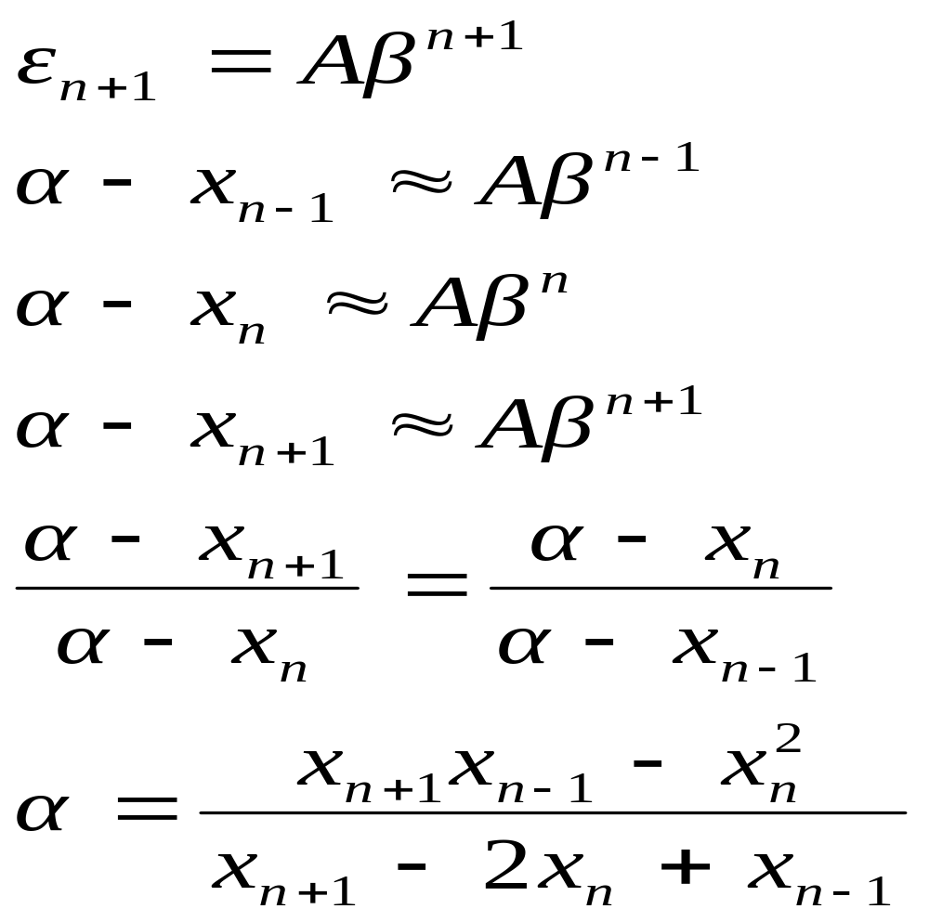
Aitken’s process

Slide 19
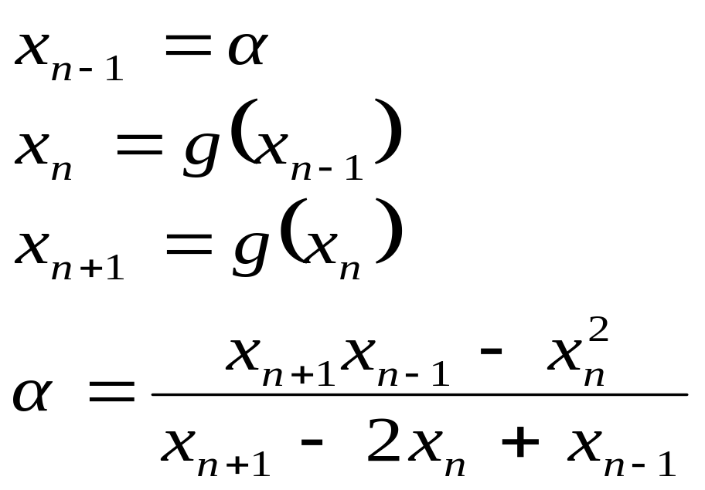
Algorithm
α ← guess_value;
while (! α ≈ g(α)) {
}

Slide 20
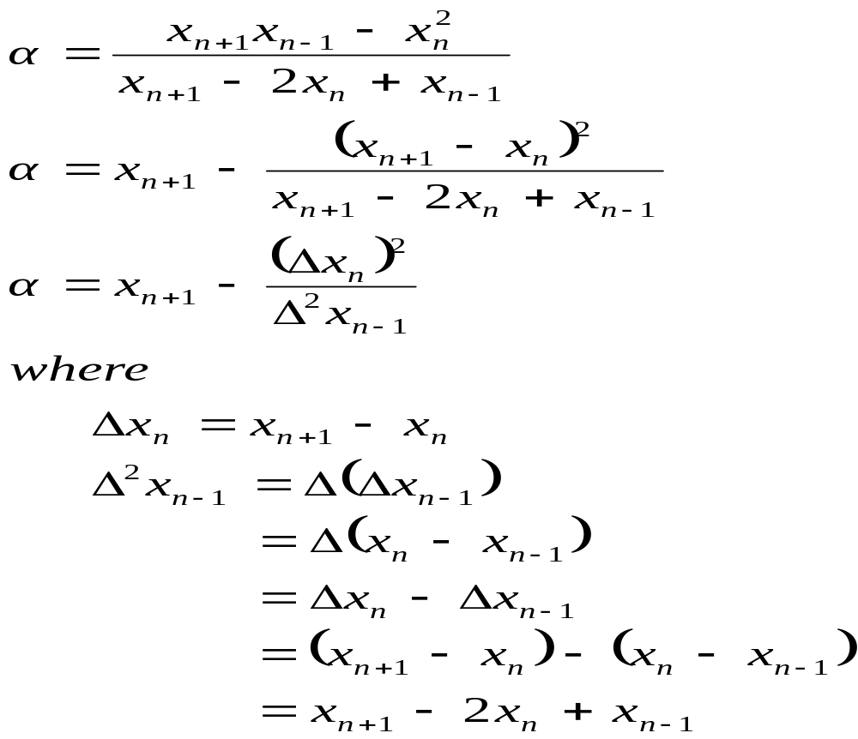
Why Δ²?

